Slide 1
National Group Conference: Session IV
ETS6 Roadmap
Michael Critchfield

Slide 2

Agenda
Current State
Autumn Release
Features 2024
Features 2025
ETS Strategy
Network Security
Discussion

Slide 3

Current State
ETS6.0.0 was released in September 2021
  It introduced many changes to Workflows
    Archive Folders and Modes, Catalog and Diagnostics only in Project Context, …
  It introduced a lot of System Extensions
    Segment Couplers, Secure Proxies, …
  It was flawed and took some getting used to
    Dashboard Tiles, Sign Up and Licensing, Bugs, …
ETS6.0.1 – ETS6.1.0: 7 Releases
  Bringing new Functionalities
  Fixing Bugs, Improving Performance
Full Time Testing of ETS inhouse since 2022. Decreasing number of Support Cases with every Release.

Slide 4

Autumn Release
Re-introduction of the “Close Panel” Button
Improving performance of Cloud Licensing and hundreds other Bugfixes
Support of KNX RF Multi Devices
Assignment of Individual Addresses by using the Device Serial Number
Introduction of the KNX Semantic Export
Enhanced context by using Functions
Search Folders
Counter for selected Items
Archive Improvements
New Diagnostic Features

Slide 5

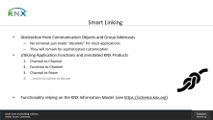
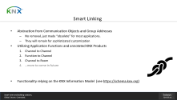
Features 2024
Support for KNX IoT Point API (see https://schema.knx.org)
Introduction of Smart Linking to ETS
Firmware Update native in ETS (KNX System Group)
BIM Import (Building Structure)
More Bugfixes, Improvements and Resilience!

Slide 6

Features 2025
Extended Focus on Functions and Device Channels
Improvements to the FDSK Workflow (KNX System Group)
Benefits from Semantic Meaning in KNX Installations
More Bugfixes and Improvements!

Slide 7
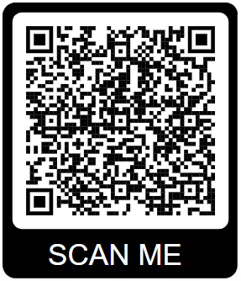

ETS Strategy
ETS Professional shall become more efficient to work with
  Streamlining Processes, improving Performance
  Utilizing Semantics along the entire Process: Planning, Programming, Commissioning, Maintenance
  Aligning the Software to the needs of Professional Users (KNX Partners and System Integrators)
ETS Home shall become easier to handle
  Lowering Thresholds, shortening Onboarding
  Focusing on what is strictly needed
  Aligning the Software to the interests of Building Managers and Home Owners
Join our ETS Workshop Participant Pool

Slide 8

Network Security
Thousands of Routers globally have Port 3671 open.
Many of those are connected to KNX Installations without KNX Secure
KNX Association recommends…
  using KNX Secure (Data Secure and IP Secure)
  using Secure Remote Gateways and closing Ports
  using Virtual Private Networks (VPNs)
  using Programming Locks
Check the status of your Installation: https://secure.knx.org

Slide 9

Discussion
ETS6
KNX Secure
Bus Interface
Flags
…

Slide 10
Michael Critchfield
ETS Product Manager
michael.critchfield@knx.org

Slide 11

Smart Linking
Abstraction from Communication Objects and Group Addresses
  No removal, just made “obsolete” for most applications.
  They will remain for sophisticated customization
Utilizing Application Functions and annotated KNX Products
  Channel to Channel
  Function to Channel
  Channel to Room
  …more to come in future
Functionality relying on the KNX Information Model (see https://schema.knx.org)

